Slide 1
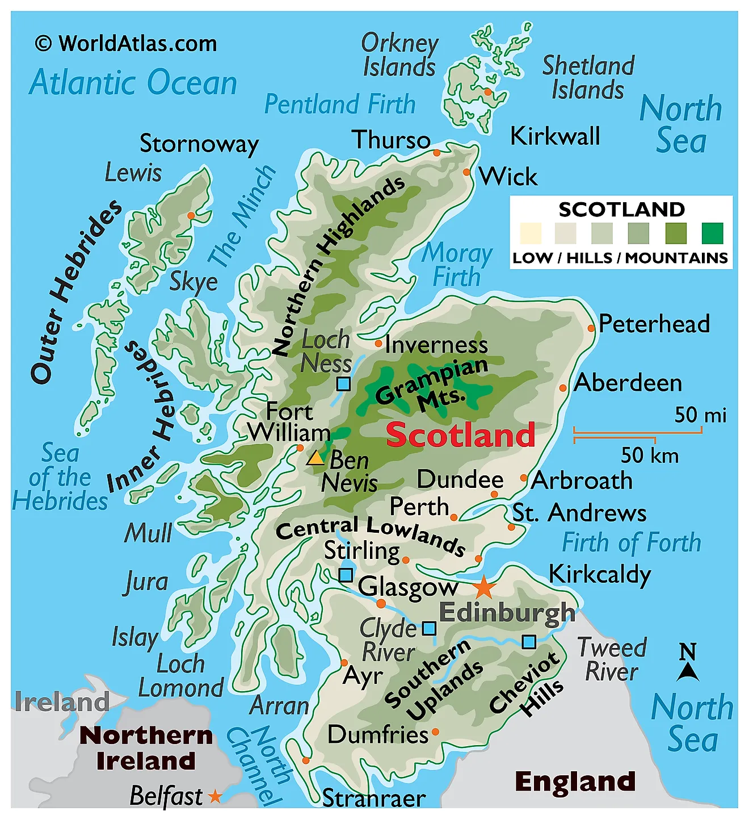
Long COVID
Fibromyalgia
ME/CFS

Slide 2
Long COVID
Fibromyalgia
ME/CFS
Inverness
Lossiemouth
Moray
Cumbernauld
Insch (Aberdeenshire)
Aberdeen
Glasgow
Tayside/Perth/Angus
Cathcart (Glasgow)
Montrose
Paisley
St Andrews
Inverclyde
Glenrothes (Fife)
Ardrossan (North Ayrshire)
Coaltown of Wemyss (Fife)
Edinburgh & Lothians
Irvine
West Lothian
Kilmarnock
Falkirk
Stranraer
Grangemouth
Wigtown
Newarthill (North Lanarkshire)

